Slide 1
P&S Heterogeneous Systems Parallel Patterns: Prefix Sum (Scan)
Dr. Juan Gómez Luna
Prof. Onur Mutlu
ETH Zürich
Spring 2022
10 May 2022

Slide 2
Parallel Patterns

Slide 3
Reduction Operation
A reduction operation reduces a set of values to a single value
Sum, Product, Minimum, Maximum are examples
Properties of reduction
Associativity
Commutativity
Identity value
Reduction is a key primitive for parallel computing
E.g., MapReduce programming model
Dean and Ghemawat, “MapReduce: Simplified Data Processing of Large Clusters,” OSDI 2004

Slide 4
Divergence-Free Mapping (I)
All active threads belong to the same warp
Thread 0
Thread 1
Thread 2
…
Thread 14
Thread 15
0
1
2
3
…
13
14
15
16
17
18
19
1
0+16
15+31
2
iterations
3
Slide credit: Hwu & Kirk

Slide 5
Divergence-Free Mapping (II)
Program with high SIMD utilization
__shared__ float partialSum[]
unsigned int t = threadIdx.x;
for(int stride = blockDim.x; stride > 0; stride >> 1){
__syncthreads();
if (t < stride)
partialSum[t] += partialSum[t + stride];
}
Warp 0
Warp 1
Warp 2
Warp 3
stride = 16
Warp utilization
is maximized
stride = 8
stride = 4

Slide 6
Histogram Computation
Histogram is a frequently used computation for reducing the dimensionality and extracting notable features and patterns from large data sets
Feature extraction for object recognition in images
Fraud detection in credit card transactions
Correlating heavenly object movements in astrophysics
…
Basic histograms - for each element in the data set, use the value to identify a “bin” to increment
Divide possible input value range into “bins”
Associate a counter to each bin
For each input element, examine its value and determine the bin it falls into and increment the counter for that bin
Slide credit: Hwu & Kirk

Slide 7
Parallel Histogram Computation: Iteration 2
All threads move to the next section of the input
Each thread moves to element threadID + #threads
I
_
C
A
L
C
U
L
A
T
E
_
A
_
H
I
S
T
O
G
R
A
M
Thread 0
Thread 1
Thread 2
Thread 3
We need to use atomic operations
1
1
2
1
1
2
1
_
A
B
C
D
E
F
G
H
I
J
K
L
M
N
O
P
Q
R
S
T
U
V …

Slide 8
Histogram Privatization
Privatization: Per-block sub-histograms in shared memory
Threads use atomic operations in shared memory
Block 0’s sub-histo
Block 1’s sub-histo
Block 2’s sub-histo
Block 3’s sub-histo
Shared memory
Parallel reduction
Global memory
Final histogram

Slide 9
Convolution Applications
Convolution is a widely-used operation in signal processing, image processing, video processing, and computer vision
Convolution applies a filter or mask or kernel* on each element of the input (e.g., a signal, an image, a frame) to obtain a new value, which is a weighted sum of a set of neighboring input elements
Smoothing, sharpening, or blurring an image
Finding edges in an image
Removing noise, etc.
Applications in machine learning and artificial intelligence
Convolutional Neural Networks (CNN or ConvNets)
* The term “kernel” may create confusion in the context of GPUs (recall a CUDA/GPU kernel is a function executed by a GPU)

Slide 10
1D Convolution Example
Commonly used for audio processing
Mask size is usually an odd number of elements for symmetry (5 in this example)
Calculation of P[2]:
N
N[0]
N[1]
N[2]
N[3]
N[4]
N[5]
N[6]
P
P[0]
P[1]
P[2]
P[3]
P[4]
P[5]
P[6]
1
2
3
4
5
6
7
3
8
57
16
15
3
3
Sum
M
M[0]
M[1]
M[2]
M[3]
M[4]
3
8
15
16
15
3
4
5
4
3
Partial products
Slide credit: Hwu & Kirk

Slide 11
Another Example of 2D Convolution
Input Layer
Output Layer
X
CNN filter
Y
1
2
3
4
5
6
7
1
2
3
4
5
W
2
3
4
5
6
2
3
4
5
6
7
8
1
2
3
2
1
3
4
5
6
7
8
9
2
3
4
3
2
3
4
321
6
7
4
5
6
7
8
5
6
3
4
5
4
3
4
5
6
7
8
2
3
4
3
2
5
6
7
8
5
5
6
7
8
5
6
7
1
2
3
2
1
6
7
8
9
0
1
2
7
8
9
0
1
2
3
1
4
9
8
5
Sum
Partial products
4
9
16
15
12
9
16
25
24
21
8
15
24
21
16
5
12
21
16
5
Slide credit: Hwu & Kirk

Slide 12
Implementing a Convolutional Layer with Matrix Multiplication
Slide credit: Reproduced from Hwu & Kirk

Slide 13
Prefix Sum (Scan)

Slide 14
Prefix Sum (Scan)
Prefix sum or scan is an operation that takes an input array and an associative operator,
E.g., addition, multiplication, maximum, minimum
And returns an output array that is the result of recursively applying the associative operator on the elements of the input array
Input array [x₀, x₁, …, x_{n-1}]
Associative operator ⊕
An output array [y₀, y₁, …, y_{n-1}] where
Exclusive scan: y_{i} = x₀ ⊕ x₁ ⊕ ... ⊕ x_{i-1}
Inclusive scan: y_{i} = x₀ ⊕ x₁ ⊕ ... ⊕ x_{i}

Slide 15
Scan Applications
Scan is a key parallel primitive that can
convert recurrences from sequential
into parallel
Scan is a basic building block of many parallel algorithms
E.g., stream compaction, partition, select, unique, radix sort, quicksort, string comparison, lexical analysis, polynomial evaluation, solving recurrences, tree operations, histograms, etc.
for(int i=1; i<n; i++)
out[i] = out[i-1] + f(i);
forall(i) {temp = f(i)};
scan(out, temp);

Slide 16
Examples of Exclusive and Inclusive Scan
Input
1
2
3
4
1
1
1
1
0
1
2
3
2
2
2
2
Output (Exclusive Scan)
out[0] = 0; // Identity value
for(int i=1; i<n; i++)
out[i] = out[i-1] + in[i-1];
0
1
3
6
10
11
12
13
14
14
15
17
20
22
24
26
Output (Inclusive Scan)
out[0] = in[0];
for(int i=1; i<n; i++)
out[i] = out[i-1] + in[i];
1
3
6
10
11
12
13
14
14
15
17
20
22
24
26
28

Slide 17
Hierarchical (Inclusive) Scan
Input
Block 0
Block 1
Block 2
Block 3
1
2
3
4
1
1
1
1
0
1
2
3
2
2
2
2
Per-block (Inclusive) Scan
1
3
6
10
1
2
3
4
0
1
3
6
2
4
6
8
Output (Inclusive Scan)
1
3
6
10
11
12
13
14
14
14
15
17
20
20
22
24
26
28

Slide 18
Hierarchical (Inclusive) Scan
Input
Block 0
Block 1
Block 2
Block 3
1
2
3
4
1
1
1
1
0
1
2
3
2
2
2
2
Per-block (Inclusive) Scan
1
3
6
10
10
1
2
3
4
4
0
1
3
6
6
2
4
6
8
8
10
4
6
8
Scan Partial Sums
10
14
20
28
Add
1
3
6
10
1
2
3
4
0
1
3
6
2
4
6
8
Output (Inclusive Scan)
+10
+14
+20
1
3
6
10
11
11
12
12
13
13
14
14
14
14
15
15
17
17
20
20
22
22
24
24
26
26
28
28

Slide 19
Hierarchical (Inclusive) Scan
Input
Block 0
Block 1
Block 2
Block 3
1
2
3
4
1
1
1
1
0
1
2
3
2
2
2
2
Per-block (Inclusive) Scan
1
3
6
10
10
1
2
3
4
4
0
1
3
6
6
2
4
6
8
8
10
4
6
8
Inter-block synchronization
Kernel termination and
Scan on CPU, or
Launch new scan kernel on GPU
Atomic operations in global memory
Scan Partial Sums
10
14
20
28
Add
1
3
6
10
1
2
3
4
0
1
3
6
2
4
6
8
Output (Inclusive Scan)
+10
+14
+20
1
3
6
10
11
11
12
12
13
13
14
14
14
14
15
15
17
17
20
20
22
22
24
24
26
26
28
28

Slide 20
Per-Block (Inclusive) Scan
Inside a thread block, we can also apply a hierarchical approach
Warps
Threads
Let’s start with the basic algorithms
Kogge-Stone
Brent-Kung

Slide 21
Kogge-Stone Parallel (Inclusive) Scan
x₀ | x₁ | x₂ | x₃ | x₄ | x₅ | x₆ | x₇
x₀ | x₀..x₁ | x₁..x₂ | x₂..x₃ | x₃..x₄ | x₄..x₅ | x₅..x₆ | x₆..x₇
x₀ | x₀..x₁ | x₀..x₂ | x₀..x₃ | x₁..x₄ | x₂..x₅ | x₃..x₆ | x₄..x₇
x₀ | x₀..x₁ | x₀..x₂ | x₀..x₃ | x₀..x₄ | x₀..x₅ | x₀..x₆ | x₀..x₇
Slide credit: Izzat El Hajj

Slide 22
Kogge-Stone Parallel (Inclusive) Scan Code
unsigned int i = blockIdx.x*blockDim.x + threadIdx.x;
output[i] = input[i];
__syncthreads();
for(unsigned int stride = 1; stride <= BLOCK_DIM/2; stride *= 2) {
float v;
if(threadIdx.x >= stride) {
v = output[i - stride];
}
__syncthreads();
if(threadIdx.x >= stride) {
output[i] += v;
}
__syncthreads();
}
if(threadIdx.x == BLOCK_DIM - 1) {
partialSums[blockIdx.x] = output[i];
}
Wait for everyone to read before updating
Slide credit: Izzat El Hajj

Slide 23
Kogge-Stone Parallel (Inclusive) Scan
x₀ | x₁ | x₂ | x₃ | x₄ | x₅ | x₆ | x₇
x₀ | x₀..x₁ | x₁..x₂ | x₂..x₃ | x₃..x₄ | x₄..x₅ | x₅..x₆ | x₆..x₇
Observation: memory locations are reused
x₀ | x₀..x₁ | x₀..x₂ | x₀..x₃ | x₁..x₄ | x₂..x₅ | x₃..x₆ | x₄..x₇
x₀ | x₀..x₁ | x₀..x₂ | x₀..x₃ | x₀..x₄ | x₀..x₅ | x₀..x₆ | x₀..x₇
Slide credit: Izzat El Hajj

Slide 24
Using Shared Memory
x₀ | x₁ | x₂ | x₃ | x₄ | x₅ | x₆ | x₇
Optimization: load once to a shared memory buffer and perform successive reads and writes to the same array can be done in shared memory
x₀ | x₀..x₁ | x₁..x₂ | x₂..x₃ | x₃..x₄ | x₄..x₅ | x₅..x₆ | x₆..x₇
x₀ | x₀..x₁ | x₀..x₂ | x₀..x₃ | x₁..x₄ | x₂..x₅ | x₃..x₆ | x₄..x₇
x₀ | x₀..x₁ | x₀..x₂ | x₀..x₃ | x₀..x₄ | x₀..x₅ | x₀..x₆ | x₀..x₇
Slide credit: Izzat El Hajj

Slide 25
Using Shared Memory Code
unsigned int i = blockIdx.x*blockDim.x + threadIdx.x;
__shared__ float buffer_s[BLOCK_DIM];
buffer_s[threadIdx.x] = input[i];
__syncthreads();
for(unsigned int stride = 1; stride <= BLOCK_DIM/2; stride *= 2) {
float v;
if(threadIdx.x >= stride) {
v = buffer_s[threadIdx.x - stride];
}
__syncthreads();
if(threadIdx.x >= stride) {
buffer_s[threadIdx.x] += v;
}
__syncthreads();
}
if(threadIdx.x == BLOCK_DIM - 1) {
partialSums[blockIdx.x] = buffer_s[threadIdx.x];
}
output[i] = buffer_s[threadIdx.x];
Slide credit: Izzat El Hajj

Slide 26
Double Buffering
buffer1
x₀ | x₁ | x₂ | x₃ | x₄ | x₅ | x₆ | x₇
Threads not adding must copy their values
in = buffer1, out = buffer2
buffer2
x₀ | x₀..x₁ | x₁..x₂ | x₂..x₃ | x₃..x₄ | x₄..x₅ | x₅..x₆ | x₆..x₇
in = buffer2, out = buffer1
buffer1
x₀ | x₀..x₁ | x₀..x₂ | x₀..x₃ | x₁..x₄ | x₂..x₅ | x₃..x₆ | x₄..x₇
in = buffer1, out = buffer2
buffer2
x₀ | x₀..x₁ | x₀..x₂ | x₀..x₃ | x₀..x₄ | x₀..x₅ | x₀..x₆ | x₀..x₇
Optimization: eliminate one synchronization by using two buffers and alternating them as the input/output buffer (called double buffering)
Slide credit: Izzat El Hajj

Slide 27
Double Buffering
unsigned int i = blockIdx.x*blockDim.x + threadIdx.x;
__shared__ float buffer1_s[BLOCK_DIM];
__shared__ float buffer2_s[BLOCK_DIM];
float* inBuffer_s = buffer1_s;
float* outBuffer_s = buffer2_s;
inBuffer_s[threadIdx.x] = input[i];
__syncthreads();
for(unsigned int stride = 1; stride <= BLOCK_DIM/2; stride *= 2) {
if(threadIdx.x >= stride) {
outBuffer_s[threadIdx.x] =
inBuffer_s[threadIdx.x] + inBuffer_s[threadIdx.x - stride];
}
else {
outBuffer_s[threadIdx.x] = inBuffer_s[threadIdx.x];
}
__syncthreads();
float* tmp = inBuffer_s;
inBuffer_s = outBuffer_s;
outBuffer_s = tmp;
}
if(threadIdx.x == BLOCK_DIM - 1) {
partialSums[blockIdx.x] = inBuffer_s[threadIdx.x];
}
output[i] = inBuffer_s[threadIdx.x];
Slide credit: Izzat El Hajj

Slide 28
Work Efficiency
A parallel algorithm is work-efficient if it performs the same amount of work as the corresponding sequential algorithm
Scan work efficiency
Sequential scan performs N additions
Kogge-Stone parallel scan performs:
log(N) steps, N - 2^{step} operations per step
Total: (N-1) + (N-2) + (N-4) + … + (N-N/2)
= N*log(N) - (N-1) = O(N*log(N)) operations
Algorithm is not work efficient
If resources are limited, parallel algorithm will be slow because of low work efficiency
Slide credit: Izzat El Hajj

Slide 29
Brent-Kung Parallel (Inclusive) Scan
x₀ | x₁ | x₂ | x₃ | x₄ | x₅ | x₆ | x₇
One thread for every two elements
x₀ | x₀..x₁ | x₂ | x₂..x₃ | x₄ | x₄..x₅ | x₆ | x₆..x₇
Reduction Step
x₀ | x₀..x₁ | x₂ | x₀..x₃ | x₄ | x₄..x₅ | x₆ | x₄..x₇
x₀ | x₀..x₁ | x₂ | x₀..x₃ | x₄ | x₄..x₅ | x₆ | x₀..x₇
Post-Reduction Step
x₀ | x₀..x₁ | x₂ | x₀..x₃ | x₄ | x₀..x₅ | x₆ | x₀..x₇
x₀ | x₀..x₁ | x₀..x₂ | x₀..x₃ | x₀..x₄ | x₀..x₅ | x₀..x₆ | x₀..x₇
Slide credit: Izzat El Hajj

Slide 30
Work Efficiency
Recall: Kogge-Stone
log(N) steps
O(N*log(N)) operations
Brent-Kung
Reduction step:
log(N) steps
1 + 2 + 4 + … + N/2 = N-1 operations
Post-Reduction step:
log(N)-1 steps
(2-1) + (4-1) + … + (N/2-1) = (N-2) - (log(N)-1)
Total:
2*log(N)-1 steps
(N-1) + (N-2) - (log(N)-1) = 2*N – log(N) – 2 = O(N) operations
Brent-Kung takes more steps but is more work-efficient
Slide credit: Izzat El Hajj

Slide 31
Work Efficiency (the Reality)
While Brent-Kung has higher theoretical work-efficiency than Kogge-Stone, in practice, its actual resource consumption on GPUs after accounting for inactive threads is O(N*log(N))
Performance of Brent-Kung on GPUs is similar or may even be worse than Kogge-Stone
Still is an interesting case to study
Slide credit: Izzat El Hajj

Slide 32
Recall: Warp Shuffle Functions
Built-in warp shuffle functions enable threads to share data with other threads in the same warp
Faster than using shared memory and __syncthreads() to share across threads in the same block
Variants:
__shfl_sync(mask, var, srcLane)
Direct copy from indexed lane
__shfl_up_sync(mask, var, delta)
Copy from a lane with lower ID relative to caller
__shfl_down_sync(mask, var, delta)
Copy from a lane with higher ID relative to caller
__shfl_xor_sync(mask, var, laneMask)
Copy from a lane based on bitwise XOR of own lane ID
Slide credit: Izzat El Hajj

Slide 33
Recall: Per-Block (Inclusive) Scan
Inside a thread block, we can also apply a hierarchical approach
Warps
Threads
Let’s start with the basic algorithms
Kogge-Stone
Brent-Kung

Slide 34
Recall: Hierarchical (Inclusive) Scan
Input
Block 0
Block 1
Block 2
Block 3
1
2
3
4
1
1
1
1
0
1
2
3
2
2
2
2
Per-block (Inclusive) Scan
1
3
6
10
10
1
2
3
4
4
0
1
3
6
6
2
4
6
8
8
10
4
6
8
Inter-block synchronization
Kernel termination and
Scan on CPU, or
Launch new scan kernel on GPU
Atomic operations in global memory
Scan Partial Sums
10
14
20
28
Add
1
3
6
10
1
2
3
4
0
1
3
6
2
4
6
8
Output (Inclusive Scan)
+10
+14
+20
1
3
6
10
11
11
12
12
13
13
14
14
14
14
15
15
17
17
20
20
22
22
24
24
26
26
28
28

Slide 35
Per-Block Hierarchical (Inclusive) Scan
Input
Warp 0
Warp 1
Warp 2
Warp 3
1
2
3
4
1
1
1
1
0
1
2
3
2
2
2
2
Per-warp (Inclusive) Scan
1
3
6
10
10
1
2
3
4
4
0
1
3
6
6
2
4
6
8
8
10
4
6
8
Intra-block synchronization
__syncthreads();
Scan Partial Sums
10
14
20
28
Add
1
3
6
10
1
2
3
4
0
1
3
6
2
4
6
8
Output (Inclusive Scan)
+10
+14
+20
1
3
6
10
11
11
12
12
13
13
14
14
14
14
15
15
17
17
20
20
22
22
24
24
26
26
28
28

Slide 36
Warp Scan
#define WARP_SIZE 32
// Warp ID and lane ID
__device__ inline int lane_id(void) { return threadIdx.x % WARP_SIZE; }
__device__ inline int warp_id(void) { return threadIdx.x / WARP_SIZE; }
// Warp scan
__device__ int warp_scan(int val){
int x = val;
#pragma unroll
for(int offset = 1; offset < WARP_SIZE; offset <<= 1){
int y = __shfl_up_sync(0xffffffff, x, offset);
if(lane_id() >= offset)
x += y;
}
return x - val;
}

Slide 37
Per-Block Hierarchical Scan
__device__ int block_scan(int* count, int x){
__shared__ int sdata[L_DIM];
// A. Exclusive scan within each warp
int warpPrefix = warp_scan(x);
// B. Store in shared memory
if(lane_id() == WARP_SIZE - 1)
sdata[warp_id()] = warpPrefix + x;
__syncthreads();
// C. One warp scans in shared memory
if(threadIdx.x < WARP_SIZE)
sdata[threadIdx.x] = warp_scan(sdata[threadIdx.x]);
__syncthreads();
// D. Each thread calculates its final value
int thread_out_element = warpPrefix + sdata[warp_id()];
int output = thread_out_element + *count;
__syncthreads();
if(threadIdx.x == blockDim.x - 1)
*count += (thread_out_element + x);
return output;
}

Slide 38
Scan-Scan-Add (SSA)
Input
Block 0
Block 1
Block 2
Block 3
1
2
3
4
1
1
1
1
0
1
2
3
2
2
2
2
Per-block (Inclusive) Scan
1
3
6
10
10
1
2
3
4
4
0
1
3
6
6
2
4
6
8
8
10
4
6
8
Inter-block synchronization
Kernel termination and
Scan on CPU, or
Launch new scan kernel on GPU
Atomic operations in global memory
Scan Partial Sums
10
14
20
28
Add
1
3
6
10
1
2
3
4
0
1
3
6
2
4
6
8
Output (Inclusive Scan)
+10
+14
+20
1
3
6
10
11
11
12
12
13
13
14
14
14
14
15
15
17
17
20
20
22
22
24
24
26
26
28
28

Slide 39
SSA: Global Memory Accesses
Scan
First kernel reads input array (N elements) and writes array with per-block prefix sums (N elements)
Scan
Second kernel reads and writes N / BLOCK_SIZE elements
Add
Third kernel reads array with per-block prefix sums (N elements) and writes output (N elements)
4N elements are read/written

Slide 40
Reduce-Scan-Scan (RSS)
Input
Block 0
Block 1
Block 2
Block 3
1
2
3
4
1
1
1
1
0
1
2
3
2
2
2
2
Per-block Reduction
10
10
4
4
6
6
8
8
10
4
6
8
Inter-block synchronization
Kernel termination and
Scan on CPU, or
Launch scan kernel on GPU
Atomic operations in global memory
Scan Partial Sums
10
14
20
28
Per-block Scan
1
1
2
3
3
6
4
10
1
1
1
2
1
3
1
4
0
0
1
1
2
3
3
6
2
2
2
4
2
6
2
8
Output (Inclusive Scan)
+10
+14
+20
Add
1
3
6
10
11
11
12
12
13
13
14
14
14
14
15
15
17
17
20
20
22
22
24
24
26
26
28
28

Slide 41
RSS: Global Memory Accesses
Reduce
First kernel reads input array (N elements) and writes per-block reduction (N / BLOCK_SIZE elements)
Scan
Second kernel reads and writes N / BLOCK_SIZE elements
Scan
Third kernel reads input array (N elements) and scan partial sums (N / BLOCK_SIZE elements), and writes output (N elements)
3N elements are read/written

Slide 42
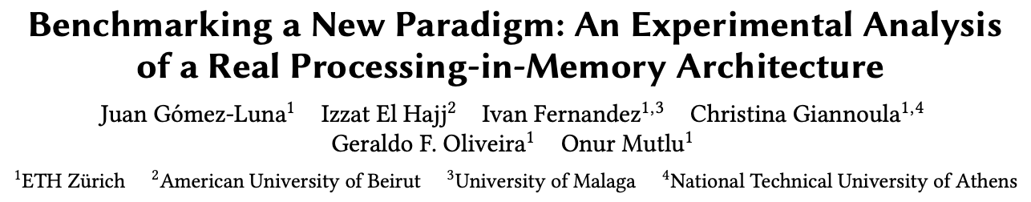
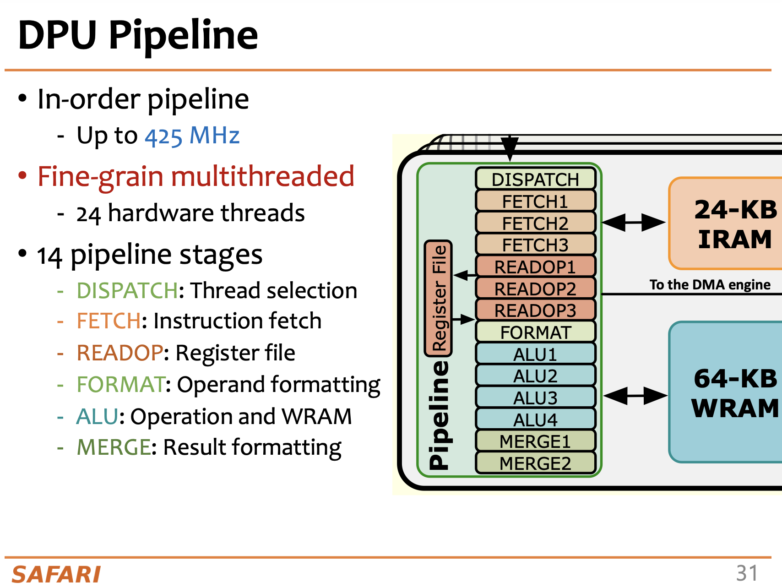
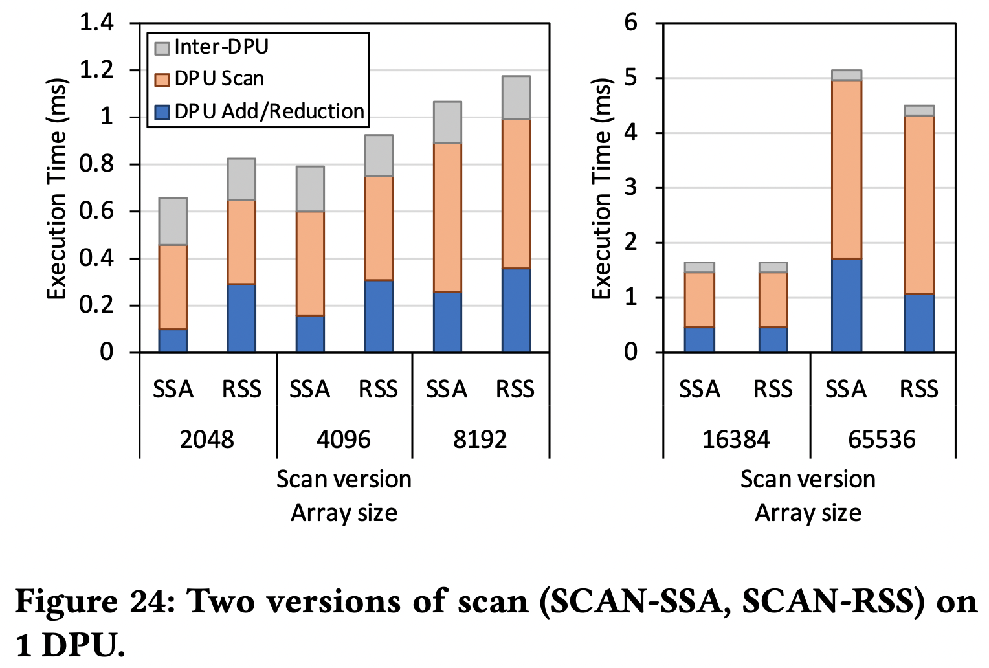
SSA vs. RSS in a FGMT Architecture
UPMEM Processing-in-Memory cores are fine-grained multithreaded
Threads (called tasklets) can use handshakes to communicate pairs of tasklets and barriers to synchronize all tasklets
https://arxiv.org/pdf/2105.03814.pdf
Processing-in-Memory Course
Lecture 2: Real-world PIM: UPMEM PIM (Spring 2022)
https://youtu.be/6dwV_RBjK2c

Slide 43
Reduction with Warp Shuffle
__global__ void reduce_kernel(float* input, float* partialSums, unsigned int N) {
unsigned int segment = 2*blockDim.x*blockIdx.x;
unsigned int i = segment + threadIdx.x;
// Load data to shared memory
__shared__ float input_s[BLOCK_DIM];
input_s[threadIdx.x] = input[i] + input[i + BLOCK_DIM];
__syncthreads();
// Reduction tree in shared memory
for(unsigned int stride = BLOCK_DIM/2; stride > WARP_SIZE; stride /= 2) {
if(threadIdx.x < stride) {
input_s[threadIdx.x] += input_s[threadIdx.x + stride];
}
__syncthreads();
}
// Reduction tree with shuffle instructions
float sum;
if(threadIdx.x < WARP_SIZE) {
sum = input_s[threadIdx.x] + input_s[threadIdx.x + WARP_SIZE];
for(unsigned int stride = WARP_SIZE/2; stride > 0; stride /= 2) {
sum += __shfl_down_sync(0xffffffff, sum, stride);
}
}
// Store partial sum
if(threadIdx.x == 0) {
partialSums[blockIdx.x] = sum;
}
}
Slide credit: Izzat El Hajj

Slide 44
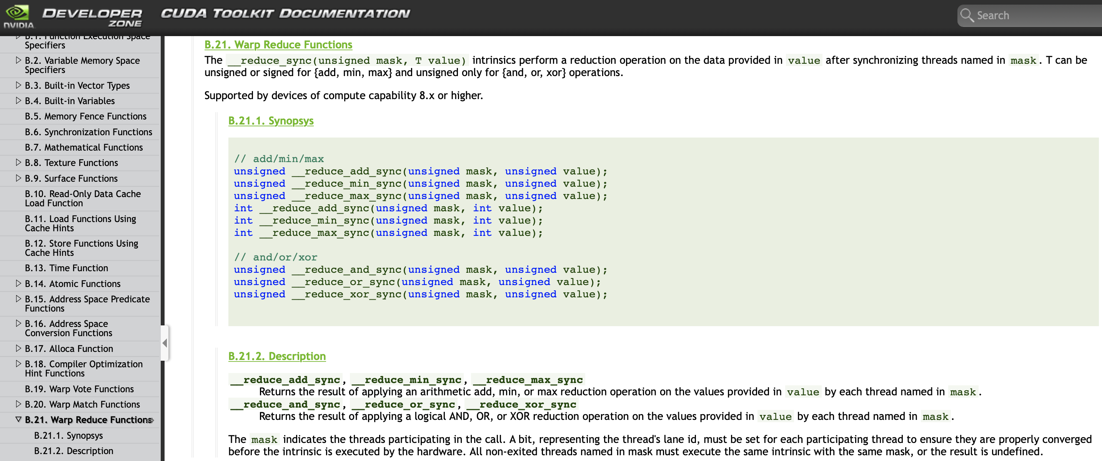
Warp Reduce Functions
Ampere (cc 8.x) adds native support for warp-wide reduction operations
https://docs.nvidia.com/cuda/cuda-c-programming-guide/index.html#warp-reduce-functions

Slide 45
Reduction with Warp Shuffle
__global__ void reduce_kernel(float* input, float* partialSums, unsigned int N) {
unsigned int segment = 2*blockDim.x*blockIdx.x;
unsigned int i = segment + threadIdx.x;
// Load data to shared memory
__shared__ float input_s[BLOCK_DIM];
input_s[threadIdx.x] = input[i] + input[i + BLOCK_DIM];
__syncthreads();
// Reduction tree in shared memory
for(unsigned int stride = BLOCK_DIM/2; stride > WARP_SIZE; stride /= 2) {
if(threadIdx.x < stride) {
input_s[threadIdx.x] += input_s[threadIdx.x + stride];
}
__syncthreads();
}
// Reduction tree with shuffle instructions
float sum;
if(threadIdx.x < WARP_SIZE) {
sum = input_s[threadIdx.x] + input_s[threadIdx.x + WARP_SIZE];
for(unsigned int stride = WARP_SIZE/2; stride > 0; stride /= 2) {
sum += __shfl_down_sync(0xffffffff, sum, stride);
}
}
// Store partial sum
if(threadIdx.x == 0) {
partialSums[blockIdx.x] = sum;
}
}
Slide credit: Izzat El Hajj

Slide 46
Reduction with Warp Reduce
__global__ void reduce_kernel(int* input, int* partialSums, unsigned int N) {
unsigned int segment = 2*blockDim.x*blockIdx.x;
unsigned int i = segment + threadIdx.x;
// Load data to shared memory
__shared__ int input_s[BLOCK_DIM];
input_s[threadIdx.x] = input[i] + input[i + BLOCK_DIM];
__syncthreads();
// Reduction tree in shared memory
for(unsigned int stride = BLOCK_DIM/2; stride > WARP_SIZE; stride /= 2) {
if(threadIdx.x < stride) {
input_s[threadIdx.x] += input_s[threadIdx.x + stride];
}
__syncthreads();
}
// Reduction with warp reduce instruction
int sum;
if(threadIdx.x < WARP_SIZE) {
sum = input_s[threadIdx.x] + input_s[threadIdx.x + WARP_SIZE];
// Warp reduce intrinsic for cc 8.0 or higher
sum = __reduce_add_sync(0xffffffff, sum);
}
// Store partial sum
if(threadIdx.x == 0) {
partialSums[blockIdx.x] = sum;
}
}

Slide 47
Reduction with a Configurable Crossbar (I)
A crossbar unit connects local register file and processing engines
Lindholm, "Reduction Operations in a Synchronous Parallel Thread Processing System with Disabled Execution Threads," US8200940B1

Slide 48
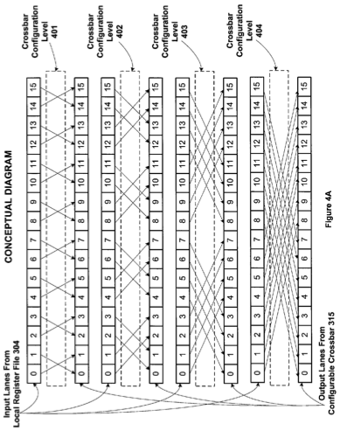
Reduction with a Configurable Crossbar (II)
Lindholm, "Reduction Operations in a Synchronous Parallel Thread Processing System with Disabled Execution Threads," US8200940B1

Slide 49
Reduction with a Configurable Crossbar (III)
An invalid value propagates and corrupts results
Lindholm, "Reduction Operations in a Synchronous Parallel Thread Processing System with Disabled Execution Threads," US8200940B1

Slide 50
Reduction with a Configurable Crossbar (IV)
Lindholm, "Reduction Operations in a Synchronous Parallel Thread Processing System with Disabled Execution Threads," US8200940B1

Slide 51
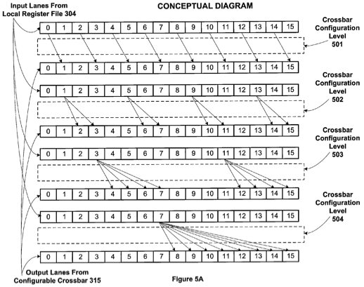
Reduction with a Configurable Crossbar (V)
Lindholm, "Reduction Operations in a Synchronous Parallel Thread Processing System with Disabled Execution Threads," US8200940B1

Slide 52
Reduction with a Configurable Crossbar (VI)
This is a prefix sum operation
Lindholm, "Reduction Operations in a Synchronous Parallel Thread Processing System with Disabled Execution Threads," US8200940B1

Slide 53
Recall: Warp Scan
#define WARP_SIZE 32
// Warp ID and lane ID
__device__ inline int lane_id(void) { return threadIdx.x % WARP_SIZE; }
__device__ inline int warp_id(void) { return threadIdx.x / WARP_SIZE; }
// Warp scan
__device__ int warp_scan(int val){
int x = val;
#pragma unroll
for(int offset = 1; offset < WARP_SIZE; offset <<= 1){
int y = __shfl_up_sync(0xffffffff, x, offset);
if(lane_id() >= offset)
x += y;
}
return x - val;
}

Slide 54
Reduce-Scan-Scan (RSS)
Input
Block 0
Block 1
Block 2
Block 3
1
2
3
4
1
1
1
1
0
1
2
3
2
2
2
2
Per-block Reduction
10
10
4
4
6
6
8
8
10
4
6
8
Inter-block synchronization
Kernel termination and
Scan on CPU, or
Launch scan kernel on GPU
Atomic operations in global memory
Scan Partial Sums
10
14
20
28
Per-block Scan
1
1
2
3
3
6
4
10
1
1
1
2
1
3
1
4
0
0
1
1
2
3
3
6
2
2
2
4
2
6
2
8
Output (Inclusive Scan)
+10
+14
+20
Add
1
3
6
10
11
11
12
12
13
13
14
14
14
14
15
15
17
17
20
20
22
22
24
24
26
26
28
28

Slide 55
Adjacent Block Synchronization

Slide 56
Adjacent Block Synchronization (I)
__shared__ float previous_sum;
if (threadIdx.x == 0){
// Wait for previous flag
while (atomicAdd(&flags[bid], 0) == 0){;}
// Read previous partial sum
previous_sum = scan_value[bid];
// Propagate partial sum
scan_value[bid + 1] = previous_sum + local_sum;
// Memory fence
__threadfence();
// Set flag
atomicAdd(&flags[bid + 1], 1);
}
__syncthreads();
flags and scan_value reside in global memory

Slide 57
Adjacent Block Synchronization (II)
__shared__ float previous_sum;
if (threadIdx.x == 0){
// Wait for previous flag
while (atomicAdd(&flags[bid], 0) == 0){;}
// Read previous partial sum
previous_sum = scan_value[bid];
// Propagate partial sum
scan_value[bid + 1] = previous_sum + local_sum;
// Memory fence
__threadfence();
// Set flag
atomicAdd(&flags[bid + 1], 1);
}
__syncthreads();
Thread blocks may not scheduled linearly (in accordance with their block ID)
In the beginning of the kernel,
we obtain a dynamic block ID:
__shared__ int sbid;
if (threadIdx.x == 0)
sbid = atomicAdd(DCounter, 1);
__syncthreads();
const int bid = sbid;
Adjacent block synchronization reduces global memory accesses from 3N (or 4N) to 2N elements
DCounter resides in global memory

Slide 58
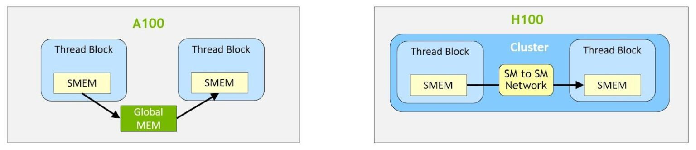
NVIDIA H100 Distributed Shared Memory
Shared memory virtual address space distributed across the blocks of a cluster
Load, store, and atomic operations to other SM’s shared memory
Thread block clusters and distributed shared memory (DSMEM) are leveraged via cooperative_groups API
TMA unit supports copies across thread blocks in a cluster
Asynchronous transaction barriers
https://developer.nvidia.com/blog/nvidia-hopper-architecture-in-depth/
Notes:
Distributed shared memory allows direct SM-to-SM communications for loads, stores, and atomics across multiple SM shared memory blocks.
Distributed shared memory enables direct SM-to-SM communications for loads, stores, and atomics across multiple SM shared memory blocks

Slide 59
Recall: Scan Applications
Scan is a key parallel primitive that can
convert recurrences from sequential
into parallel
Scan is a basic building block of many parallel algorithms
E.g., stream compaction, partition, select, unique, radix sort, quicksort, string comparison, lexical analysis, polynomial evaluation, solving recurrences, tree operations, histograms, etc.
for(int i=1; i<n; i++)
out[i] = out[i-1] + f(i);
forall(i) {temp[i] = f(i)};
scan(out, temp);

Slide 60
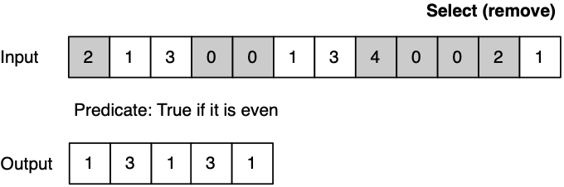
In-Place Data Sliding Algorithms (I)
Algorithms that move data in memory in one direction
Padding / Unpadding
Stream compaction
SELECT
UNIQUE
Partitioning
Etc.
Block 0
Block 1
Block 2
Gómez-Luna et al., “In-Place Data Sliding Algorithms for Many-Core Architectures,” ICPP 2015
https://github.com/el1goluj/in-place-ds-algorithms

Slide 61
In-Place Data Sliding Algorithms (II)
SELECT
~3x speedup
Gómez-Luna et al., “In-Place Data Sliding Algorithms for Many-Core Architectures,” ICPP 2015
https://github.com/el1goluj/in-place-ds-algorithms

Slide 62
Recommended Readings
Hwu and Kirk, “Programming Massively Parallel Processors,” Third Edition, 2017
Chapter 8 - Parallel patterns:
prefix sum: An introduction to
work efficiency in parallel algorithms

Slide 63
P&S Heterogeneous Systems Parallel Patterns: Prefix Sum (Scan)
Dr. Juan Gómez Luna
Prof. Onur Mutlu
ETH Zürich
Spring 2022
10 May 2022

